Slide 1
STOR 455 Transformations
Read: 1.1-1.4
Exercises: 1.27, 29abc, 31, 32abc

Slide 2
Simple Linear Model- Conditions
Model:
Linearity: The means for Y vary as a linear function of X.
Error:
Zero Mean: The distribution of the errors is centered at zero.
Constant variance: The variance for Y is the same at each X. (Homoscedasticity)
Independence: No relationships among errors.
Normality:
Residuals are normally distributed
(sometimes) At each X, the Y’s follow a normal distribution.

Slide 3
Simple Linear Model- Conditions
Model:
Linearity: The means for Y vary as a linear function of X.
Error:
Constant variance: The variance for Y is the same at each X. (Homoscedasticity)
Normality:
Residuals are normally distributed
(sometimes) At each X, the Y’s follow a normal distribution.

Slide 4
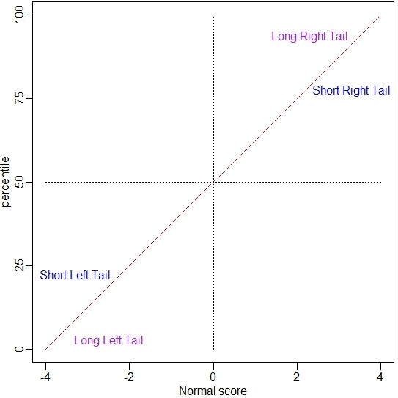
How to Read a qqplot

Slide 5
What to do when regression assumptions are violated?
Examples:
Nonlinear patterns in residuals
Heteroscedasticity (nonconstant variance)
Lack of normality in residuals
Outliers: influential points, large residuals

Slide 6
Data Transformations
Can be used to:
Address non-linear patterns
Stabilize variance
Remove skewness from residuals
Minimize effects of outliers

Slide 7





Common Transformations
For either the response (Y) or predictor (X)...
Logarithm
$$Y→log⁡(Y)$$
Square root
$$Y→\sqrt{Y}$$
Exponentiation
$$Y→e^{Y}$$
Power function
$$Y→Y^{3}$$
Reciprocal
$$Y→1/Y$$

Slide 8
Example: Planets
Y = Length of the “year” for planets
X = Distance from the sun
Try scatterplots and LM with
Year vs. Distance
log(Year) vs. Distance
Year vs. log(Distance)
log(Year) vs. log(Distance)
Which transformation gives the best linearity?

Slide 9
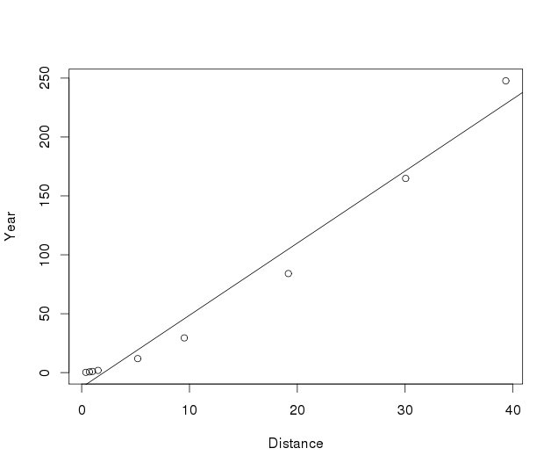
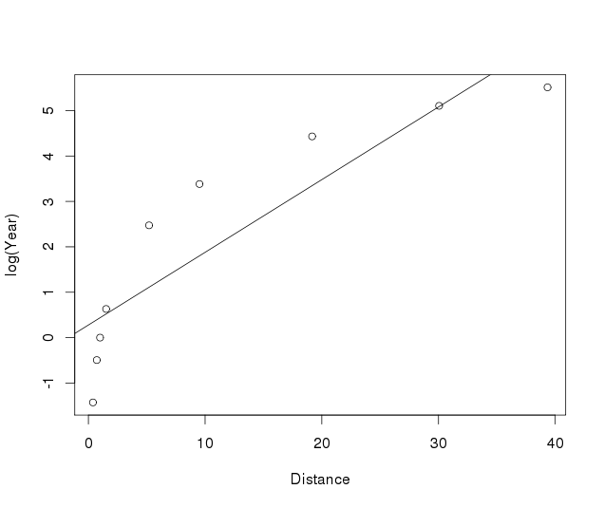
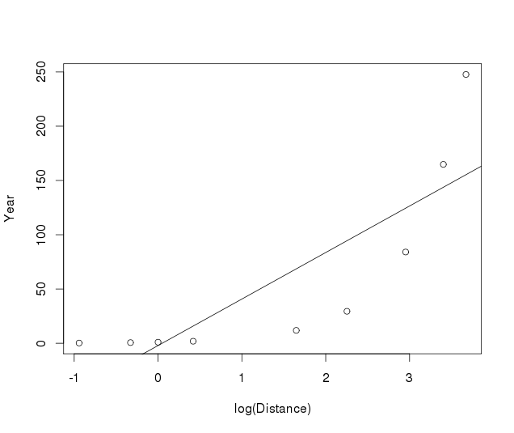
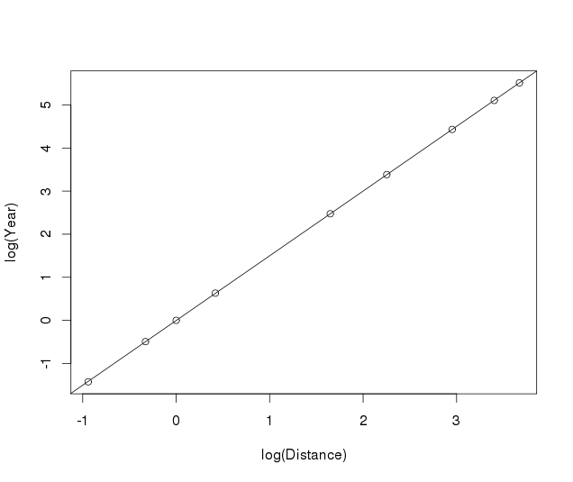
Planet Transformations

Slide 10

Fitting the Planet Model
$$log⁡(Year)=β_{0}+{β }_{1}log⁡(Distance)+ε$$
Call:
lm(formula = log(Year) ~ log(Distance), data = Planets)
Coefficients:
(Intercept) log(Distance)
-0.003434 1.502061
$$\hat{log⁡(Year)}=−0.00343+1.502∙log⁡(Distance)$$
“Exponentiate”
$$\hat{Year}=e^{−0.00343+1.502log⁡(Distance)}$$
$$={0.997∙Distance}^{1.502}$$

Slide 11
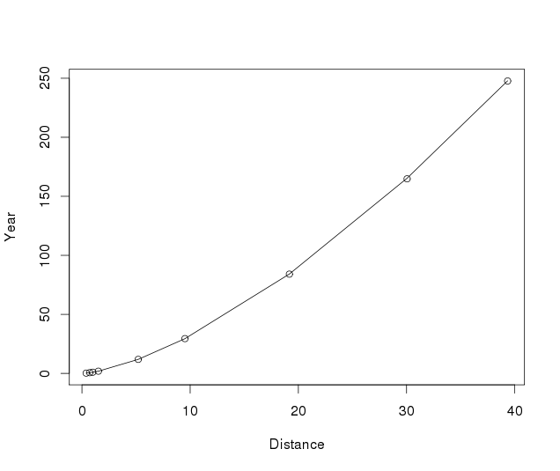
Fitting the Planet Model
plot(Year~Distance,data=Planets)
curve(0.996566*(x^1.5020611), add=TRUE)

